Slide 1


Jared Kay
23 August 2024

Slide 2

Outline
Executive Summary
Introduction
Methodology
Results
Conclusion
Appendix

Slide 3
Executive Summary
Methodologies
Data Collection via API
Data Collection via Webscraping
Data Wrangling
Data Analysis with SQL
Data Analysis with Visualization
Interactive Data Visualization with Folium and Plotly
Data Predictions using Machine Learning
Summary of Results
Data Analysis Results and Predictions
Data Visualizations
Predictive Analysis

Slide 4
Introduction
In this capstone, we will predict if the Falcon 9 first stage will land successfully. This will be accomplished by utilizing data science methodologies to garner insights related to the real-world problem.
We look to explore how launch site, payload mass, orbit type, and time affect the rates of success and failure of launches.
Predictive models will also be evaluated for how well they can predict a successful launch based on these variables.

Slide 5

Section 1

Slide 6
Methodology
Executive Summary
Data collection methodology:
Data about launches was collected using the SpaceX REST API and web scraping using Beautiful Soup on relevant Wiki pages.
Perform data wrangling
Data was processed and transformed into a cleaned data set using an API and sampling data while dealing with null values in the data set. One hot encoding was used when applicable to further make the data more manageable.
Perform exploratory data analysis (EDA) using visualization and SQL
Perform interactive visual analytics using Folium and Plotly Dash
Perform predictive analysis using classification models
Build and train predictive models before testing them to determine their accuracy

Slide 7
Data Collection
Data was initially collected using the SpaceX REST API by performing a get request
Results were viewed via the .json() method prior to using json_normalize transforming the data into a flat table
Additional data was collected using web scraping of relevant Wiki sites using Beautiful Soup and converted to a Pandas data frame
Once the data was collected it was transformed and cleaned by using APIs, data sampling, data filtering, and addressing null values
One hot encoding was used where applicable to further make the data set more manageable for future analysis

Slide 8
Data Collection – SpaceX API
Request launch data from the SpaceX API using a get request
Used json_normalize method to convert the result into a data frame
Processed data using the API to remove irrelevant data and obtain information within a specific timeframe
The resulting Pandas data frame was filtered to remove anything unrelated to Falcon9 launches
Missing values were identified and addressed by replacing (.replace) them using the mean (.mean)
Data was exported to a .cvs file for further analysis
https://github.com/unknown-user-error-py/IBM-DataScience-Capstone/blob/main/1%20-%20spacex-data-collection.ipynb
Request launch data with get request
Normalize data using json normalize
Convert result to a data frame
Process data using API to remove and filter
Filter Pandas data frame to identify Falcon9 launches
Replace missing values with the mean
Export data set to .csv

Slide 9
Data Collection - Scraping
Falcon 9 launch records were extracted from HTML tables on Wikipedia using Beautiful Soup
Data was parsed prior to extracting column and variable names from the HTML header
Created a dictionary by parsing the HTML tables prior to converting it to a Pandas dataframe
Data was exported to a .csv file for future analysis
https://github.com/unknown-user-error-py/IBM-DataScience-Capstone/blob/main/2%20-%20spacex-webscraping.ipynb
Extract Falcon9 launch records from HTML tables on Wikipedia using BeautifulSoup
Parse data
Extract data and variable names from HTML header
Create a dictionary from parsing HTML tables
Convert to Pandas data frame
Export data set to .csv

Slide 10
Data Wrangling
Data was first evaluated to identify missing values and determine the data types
The number of launches at each site was determined in addition to the number and occurrence of each orbit
They outcome for these launches was also changed to a binary system using 0 bad outcomes and 1 for good outcomes
https://github.com/unknown-user-error-py/IBM-DataScience-Capstone/blob/main/3%20-%20spacex-data-wrangling.ipynb
Identify missing values
Determine data types
Determine number of launches at each site
Determine number of launches with each orbit type
Convert launch outcomes to binary system
Export data set to .csv

Slide 11
EDA with Data Visualization
The following charts were plotted:
These plots allow for visualization and identification of relationships between the compared data inputs
https://github.com/unknown-user-error-py/IBM-DataScience-Capstone/blob/main/5%20-%20spacex-eda-data-visulization.ipynb
Flight Number vs Launch Site | Flight Number vs Orbit Type
Payload Mass vs Launch Site | Payload Mass vs Orbit Type
Success Rate vs Orbit Type | Success Rate vs Year

Slide 12
EDA with SQL
SQL Queries Performed:
https://github.com/unknown-user-error-py/IBM-DataScience-Capstone/blob/main/4%20-%20spacex-eda-sql.ipynb
Names of unique launch sites | Names of the boosters than have had a successful drone ship landing with a payload between 4,000kg and 6,000kg
5 records of launch sites beginning with ‘CCA’ | Total number of successful and failure mission outcomes
Total payload mass in kg for boosters launched by NASA | Names of boosters that have carried a maximum payload mass in kg
Average payload mass in kg for booster version F9 v1.1 | Records, including months and booster version, of failed landing outcomes on drone ships in 2015
The date of the first successful ground pad landing | Count of landing outcomes listed in descending order between 2010-06-04 and 2017-03-20

Slide 13
Build an Interactive Map with Folium
Created a blue circle at coordinates of NASA Johnson Space Center displaying both name and coordinates
Created red circles for all launch sites displaying both name and coordinates
Added green and red markers to indicate successful or failed launches at each site
Added lines from launch site ‘CCAFS SLC-40’ to the nearest coastline, railroad, highway, and city displaying the distance to each in km
These additions to the map allow for visualization of location and distance to their proximities to identify trends based on launch site location and each sites success rates
https://github.com/unknown-user-error-py/IBM-DataScience-Capstone/blob/main/6%20-%20sapcex_launch_site_location.ipynb

Slide 14
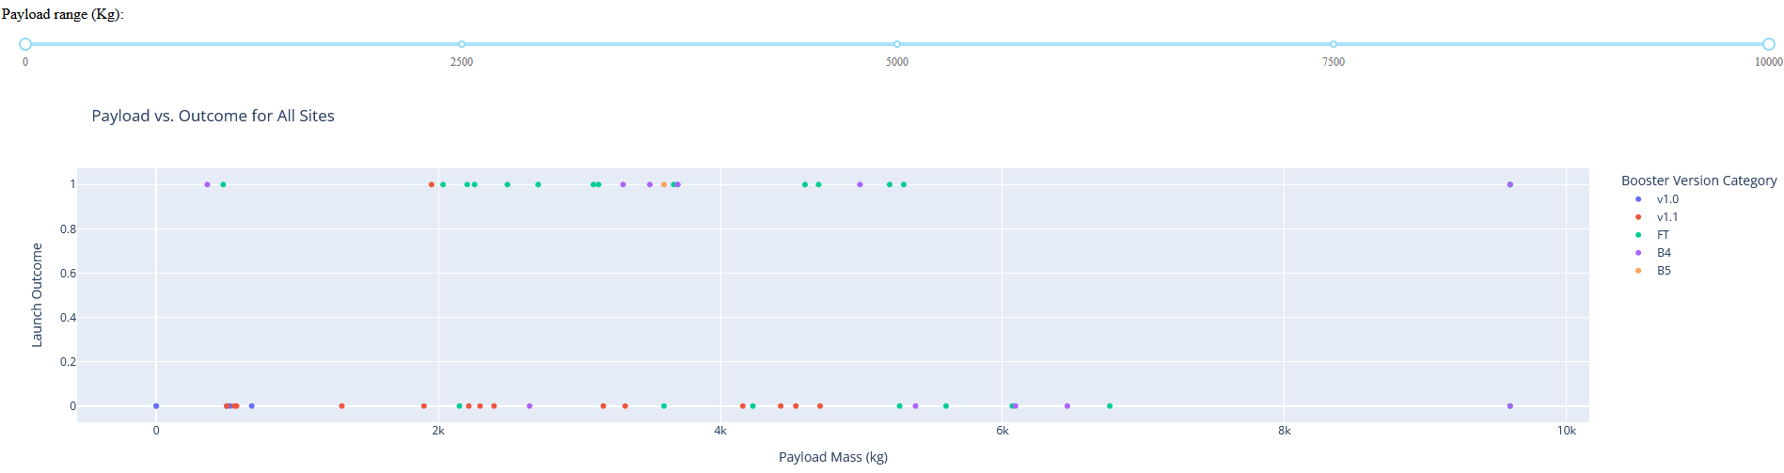
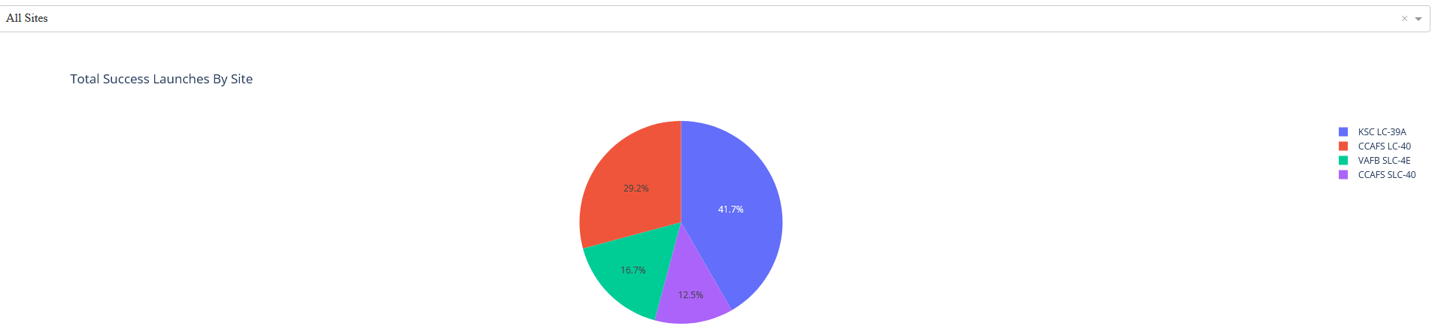
Build a Dashboard with Plotly Dash
Plots to determine success rate of launches for each site in addition to all launches were included to visually analyze success rates
Payload mass options were included to refine the weight and identify trends of successful launches when looking at booster version vs payload mass
https://github.com/unknown-user-error-py/IBM-DataScience-Capstone/blob/main/7%20-%20spacex_dashboard.py

Slide 15
Predictive Analysis (Classification)
Created a NumPy array using to_numpy() while assigning it to variable ‘Y’
Data attached to variable ‘X’ was standardized using StandardScaler
Split the data into test and training sets using train_test_split
Created logistic regression and GridSearchCV with cv=10 to determine the best parameters
Determined the best parameters using GridSearchCV for the following algorithms:
Logistic regression, support vector machine, decision tree classifier, and k nearest neighbor
Calculated accuracy for each using the test method – returning an accuracy score
Plotted each on a confusion matrix to compare predicted vs true outcomes
Determined the best performing model
https://github.com/unknown-user-error-py/IBM-DataScience-Capstone/blob/main/8%20-%20spacex_machine_learning_prediction.ipynb

Slide 16
Results
Exploratory data analysis results
Launch success rate improved with time
Flights with heavier payloads are typically more successful
Orbit type ES-L1, GEO, HEO, SSO have 100% success rates
Interactive analytics demo in screenshots
Launch sites are located near the equator and coastlines away from population centers
They maintain reasonable distance to highways and railroads presumably to transport items to launch sites
Predictive analysis results
The decision tree performed best with a test accuracy of .944

Slide 17

Section 2

Slide 18
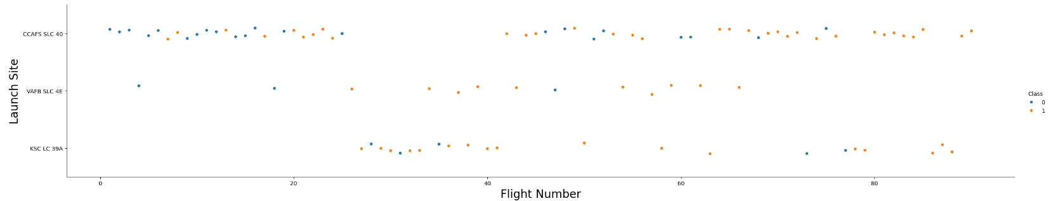
Flight Number vs. Launch Site
Scatter Plot of Flight Number vs. Launch Site
Earlier flights were more likely to be unsuccessful relative to later flights
Failed flights indicated by blue dots; successful flights indicated by orange dots
Flights from the launch sites KSC LC-39A and VAFB SLC 4E were more likely to be successful than those from CCAFS LC-40

Slide 19
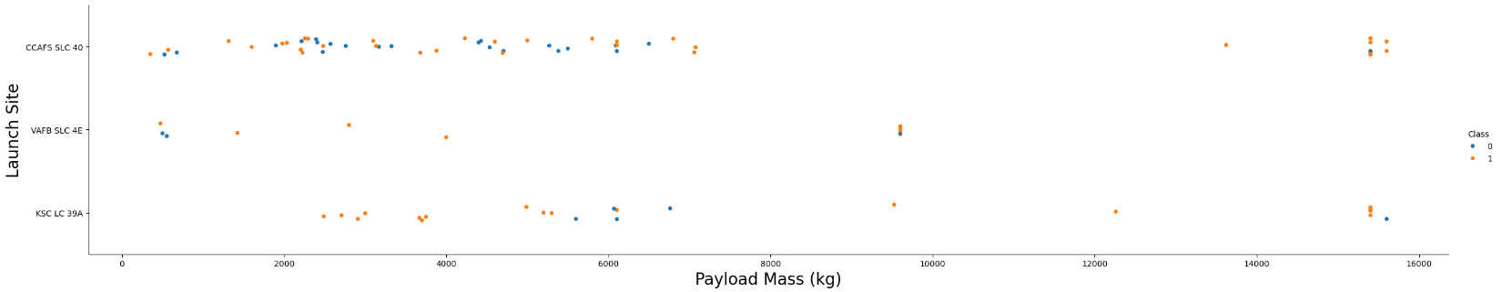
Payload vs. Launch Site
Scatter Plot of Payload Mass (kg) vs Launch Site
Launches with heavier payloads were more likely to be successful relative to lighter payloads
Failed flights indicated by blue dots; successful flights indicated by orange dots
Launch site VAFB SLC 4E has never had a launch with a payload greater than 10,000 kg
Launch site KSC LC 39A has never had a failed launch with a payload less than ~5,000 kg

Slide 20
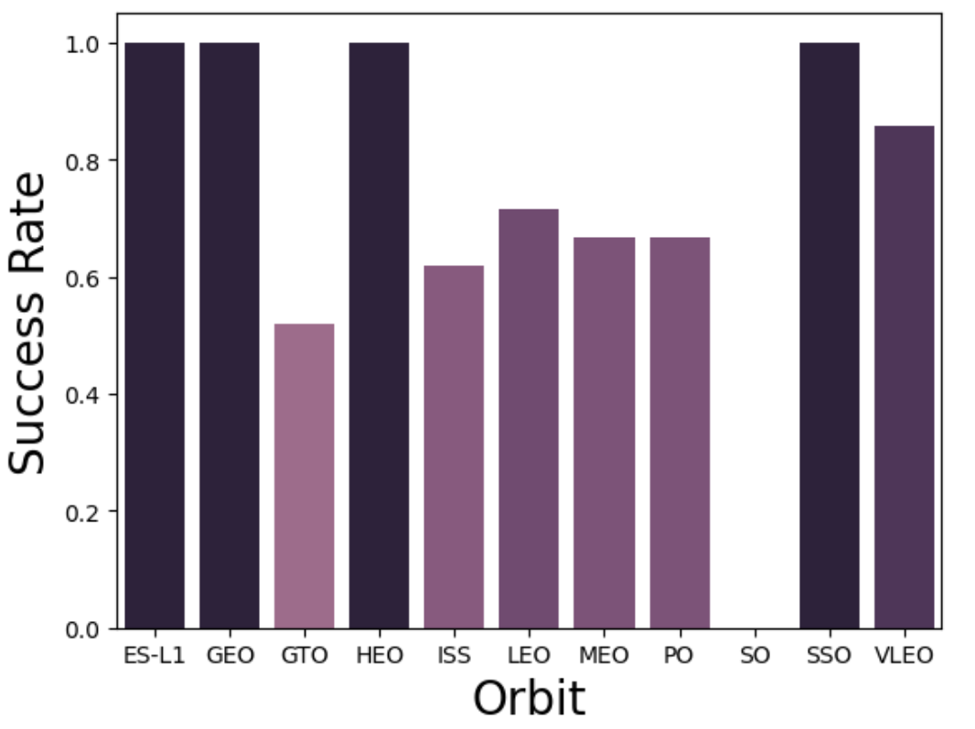
Success Rate vs. Orbit Type
Bar Plot of Success Rate vs Orbit Type
100% Success Rate
ES-L1, GEO, HEO, SSO
50%-85% Success Rate
GTO, ISS, LEO, MEO, PO, VLEO
0% Success Rate
SO

Slide 21
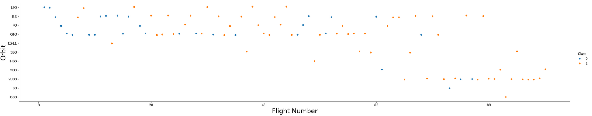
Flight Number vs. Orbit Type
Scatter Plot of Flight Number vs Orbit Type
Earlier launches were more frequently conducted at launch sites: LEO, ISS, PO, GTO
Later launches were more frequently conducted at launch sites: VLEO, SO, GEO
Success rate typically increase with additional launches at a site, GTO appears to be the exception
Failed flights indicated by blue dots; successful flights indicated by orange dots

Slide 22
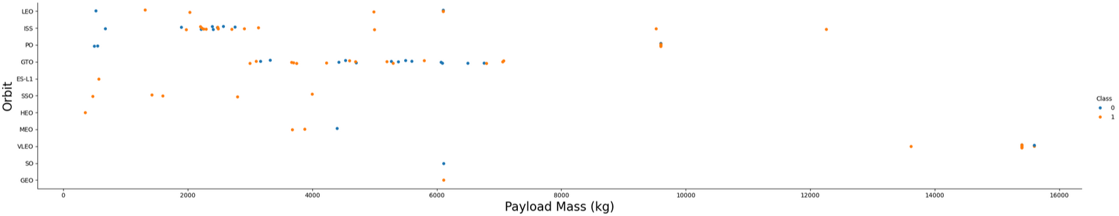
Payload vs. Orbit Type
Scatter Plot of Payload Mass (kg) vs Orbit Type
Heavier payloads are more successful when orbit type is: LEO, ISS, PO
Payload mass appears to have no impact on success rate with orbit type GTO
Failed flights indicated by blue dots; successful flights indicated by orange dots

Slide 23
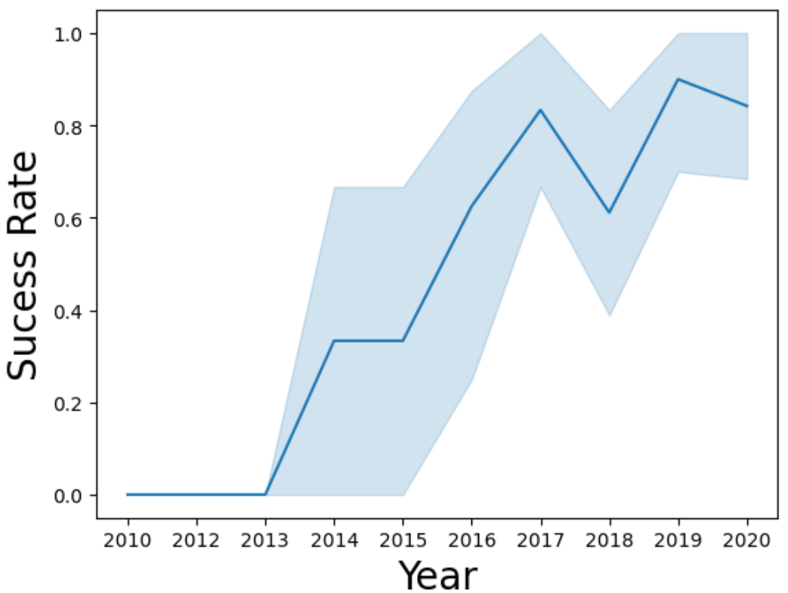
Launch Success Yearly Trend
Line Plot of Success Rate vs Year
Success rate shows a positive correlation with later years
There was a minor downturn in 2018 but the overall trend shows launches to be more successful as time goes on

Slide 24
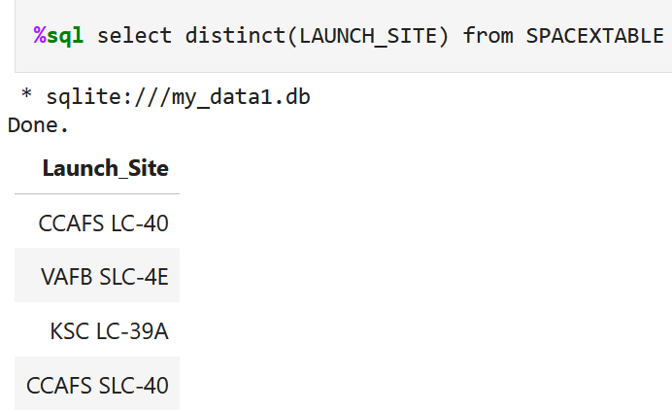
All Launch Site Names
The SPACEXTABLE was queried to request the names of distinct LAUNCH_SITE which returned the following four sites:
CCAFS LC-40
VAFB SLC-4E
KSC LC-39A
CCAFS SLC-40

Slide 25
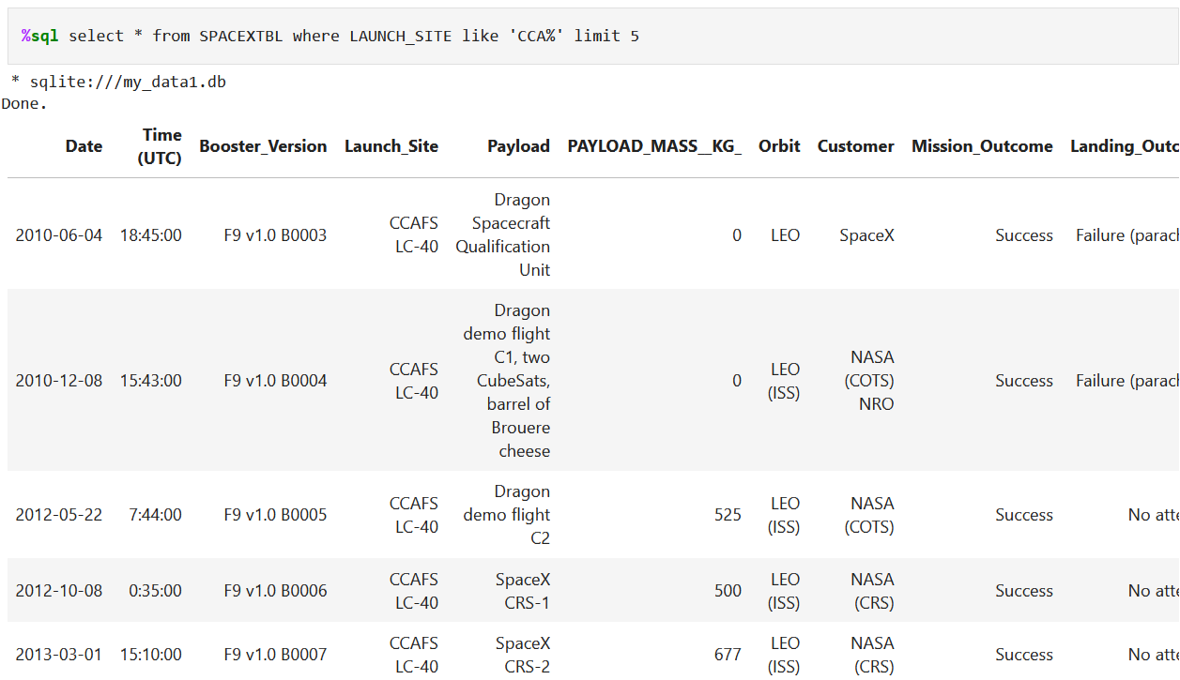
Launch Site Names Begin with 'CCA'
The SPACEXTBL was queried to request all information where the launch site began with the letters ‘CCA’ while limiting the number of results to 5

Slide 26
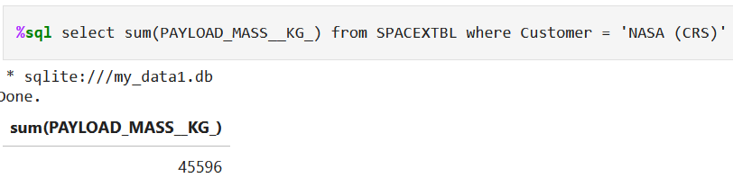
Total Payload Mass
The SPACEXTBL was queried to select the sum (total) PAYLOAD_MASS_KG while only selecting those where the customer was NASA

Slide 27
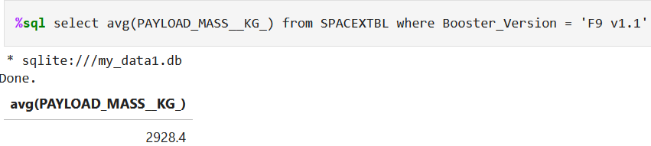
Average Payload Mass by F9 v1.1
The SPACEXTBL was queried to determine the average (avg) PAYLOAD_MASS_KG while only selecting those where the booster version was F9 v1.1

Slide 28
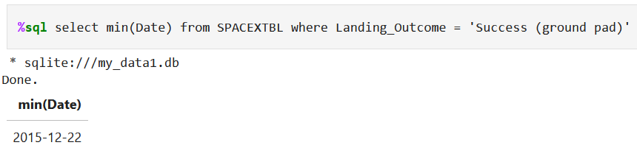
First Successful Ground Landing Date
The SPACEXTBL was queried to determine the min(Date), or earliest date, while only selecting those where the launch had a successful LANDING_OUTCOME on a ground pad

Slide 29
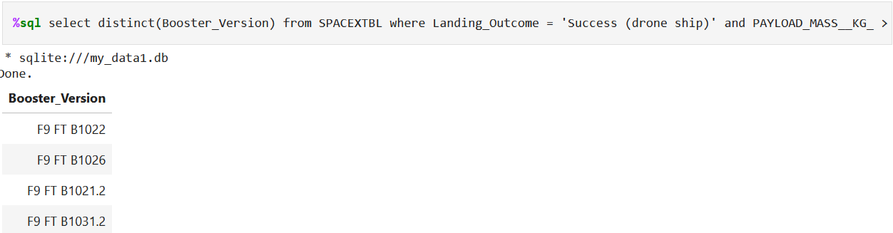
Successful Drone Ship Landing with Payload between 4000 and 6000
The SPACEXTBL was queried to determine which Booster_Version had a successful LANDING_OUTCOME on a drone ship while constraining the PAYLOAD_MASS_KG to be greater than 4,000 but less than 6,000

Slide 30
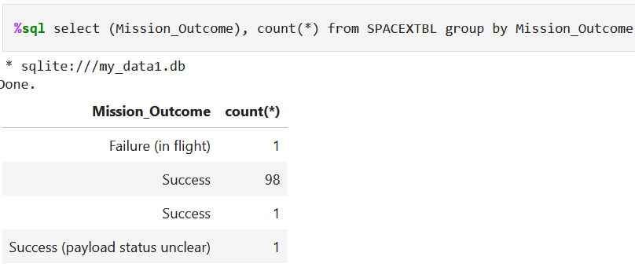
Total Number of Successful and Failure Mission Outcomes
The SPACEXTBL was queried for a count of the Mission_Outcome – there is an issue in the result of counting one of the successful missions as a different outcome when the total should be 99

Slide 31
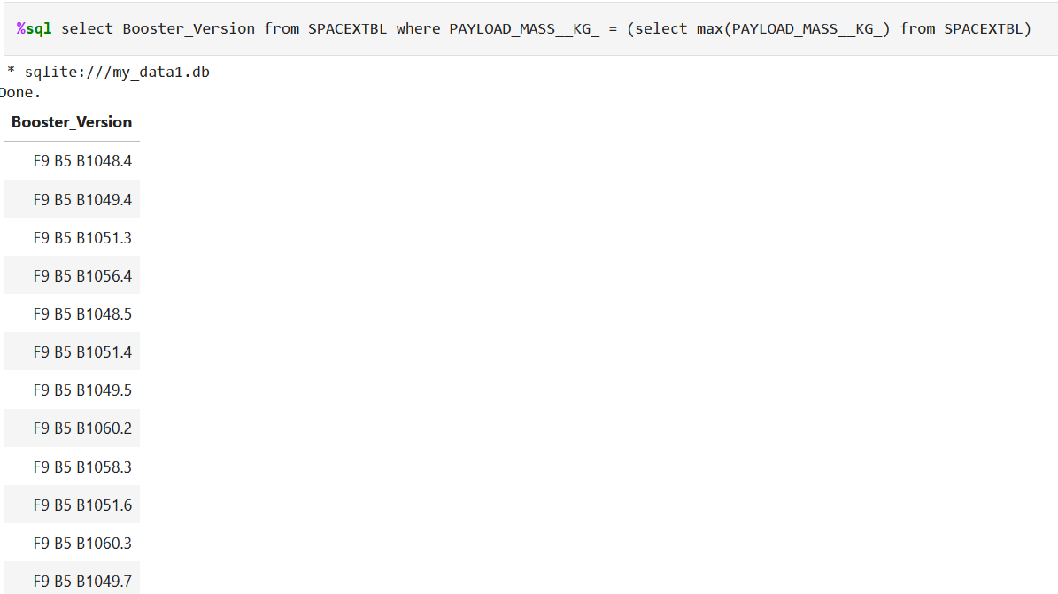
Boosters Carried Maximum Payload
The SPACEXTBL was queried to find the Booster_Version that has carried a PAYLOAD_MASS_KG equal to the max(PAYLOAD_MASS_KG) found in the table

Slide 32
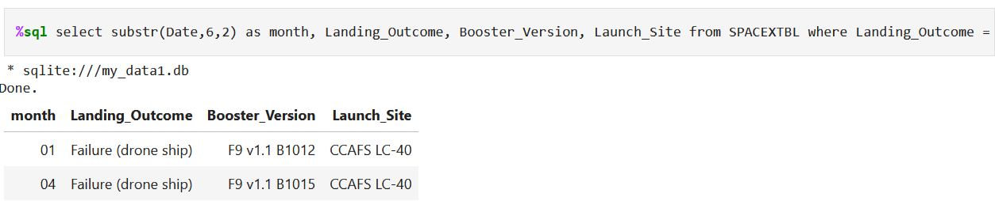
2015 Launch Records
The SPACEXTBL was queried to find the records pertaining to failed launches during the year 2015

Slide 33
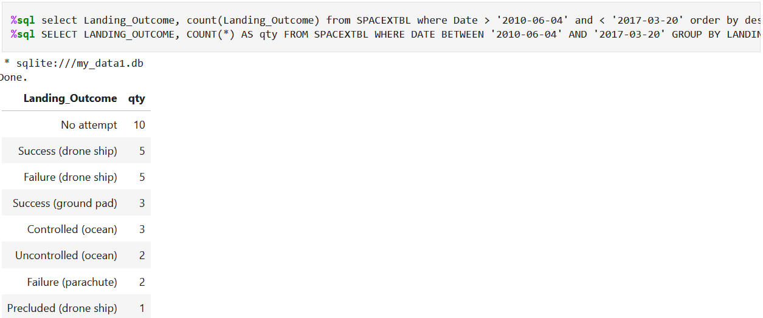
Rank Landing Outcomes Between 2010-06-04 and 2017-03-20
The SPACEXTBL was queried to count the Landing_Outcome between the dates of 2010-06-04 and 2017-03-20 and ranking them in descending order

Slide 34

Section 3

Slide 35
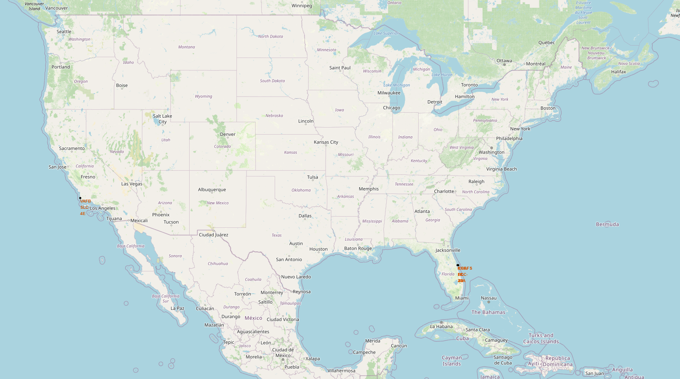
Launch Site Locations
The launch sites are located close to the equator to take advantage of Earth’s rotational speed. The Earth rotates at a speed >1650km/hr and this can be applied to the speed required to orbit the Earth. This cuts down on the amount of propellant needed to launch a spacecraft.
The launch sites are also located near the coasts far from population centers to reduce the impact to people accounting for the chance it may experience a catastrophic event.

Slide 36
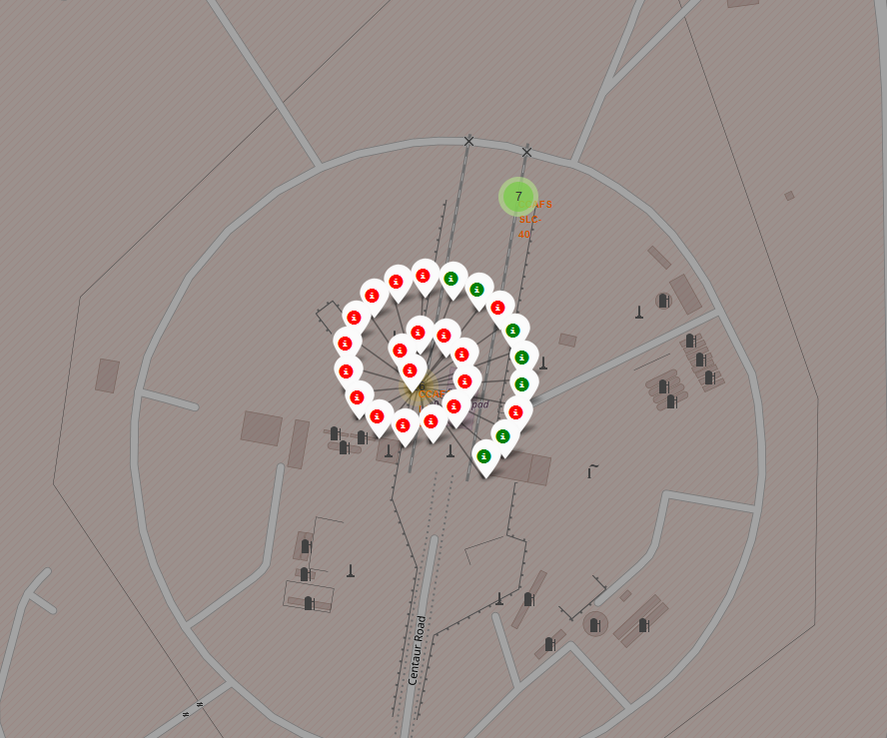
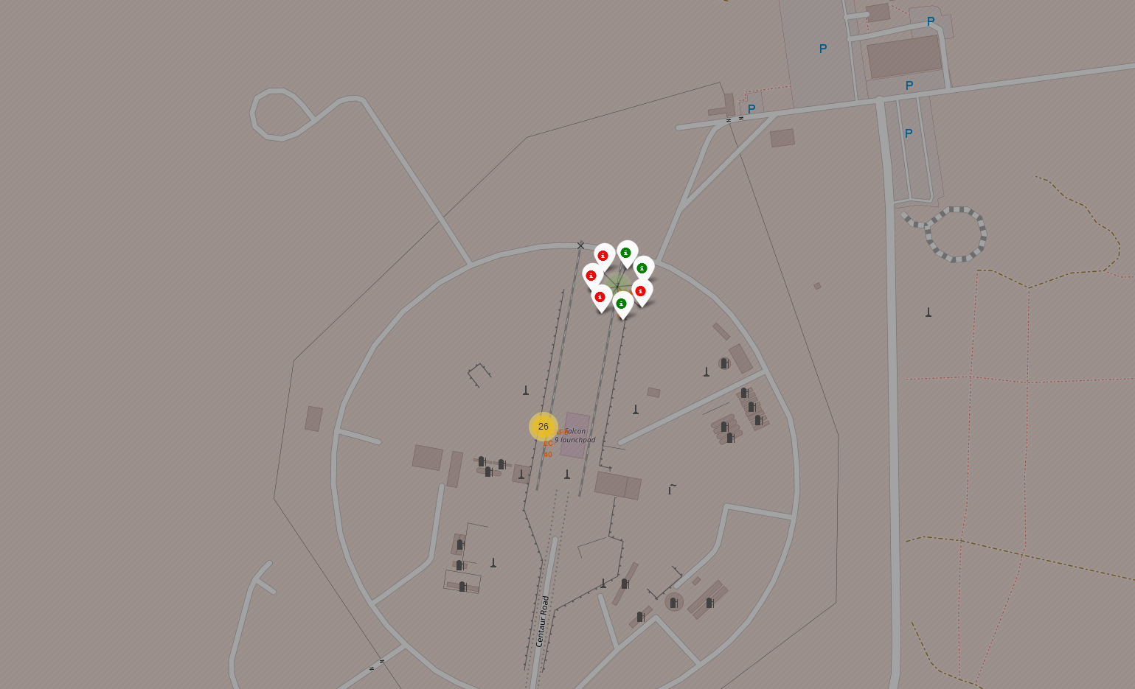
Launch Outcomes
The map displays launches at each site color coded to display the outcome
Colors indicate Successful or Unsuccessful
Using the colors it is easier to identify sites with high or low success rates

Slide 37
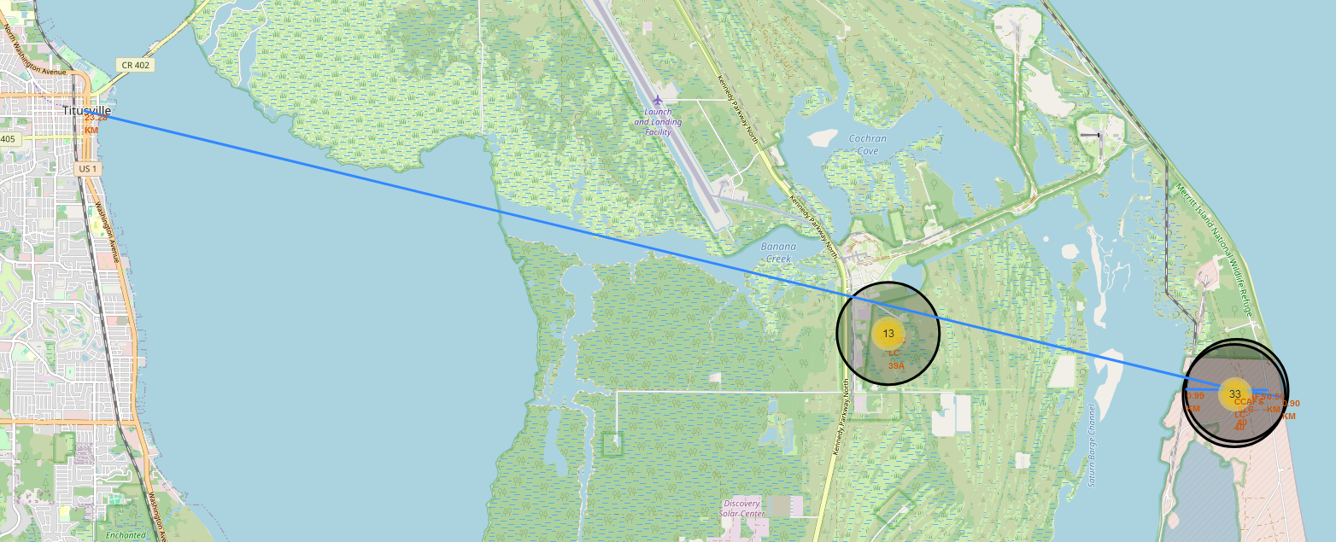
Distance of Launch Site to Proximities
Launch site CCAFS SLC-40 is located:
0.90km to the coastline, 0.59km to the nearest highway, 0.99km to the nearest railroad, and 23.28km to the city of Titusville
The launch site is located away from a population center and near the coast while maintain adequate distance to highways and railroads to move materials and people to the site as needed

Slide 38

Section 4

Slide 39
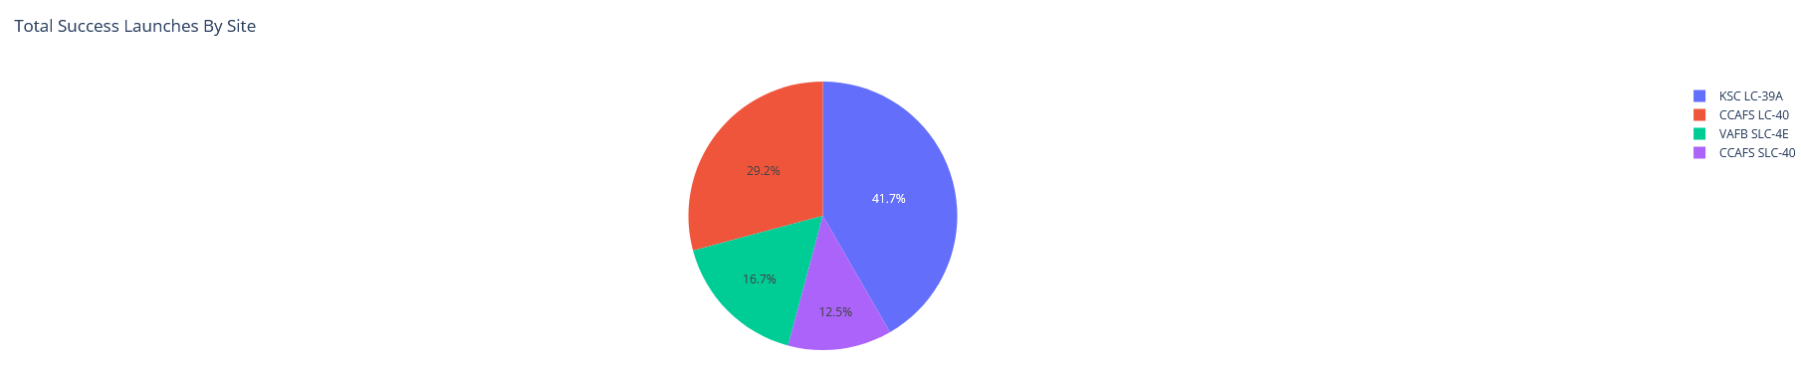
Total Successful Launches – All Sites
The pie chart shows the percentage of successful launches for each site
The most successful site is KSC LC-39A with 41.7% of all successful launches coming from this site
The least successful site is CCAFS SLC-40 with 12.5% all successful launches coming from this site

Slide 40
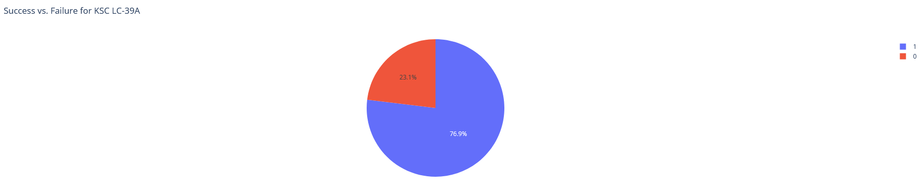
Success & Failure Percentage for Site KSC LC-39A
KSC LC-39A has a 76.9% successful launch rate while 23.1% of launches fail

Slide 41
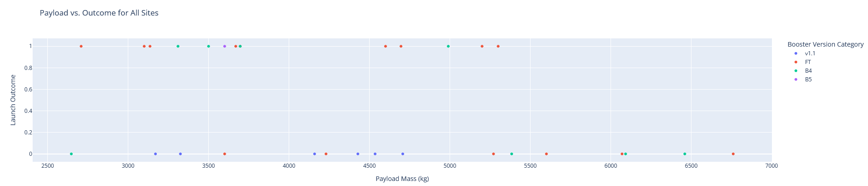
Launch Success w. Payload >2,500kg and <,7,500kg
Booster version FT is the most frequently used for payload mass between 2,500kg and 7,500kg
Booster version v1.1 always fails for payload mass between 2,500kg and 7,500kg
Booster version v1.1 and B5 are more frequently used <5,000kg

Slide 42

Section 5

Slide 43
Classification Accuracy
Decision Tree Classification returned the highest accuracy score for both training and test data sets

Slide 44
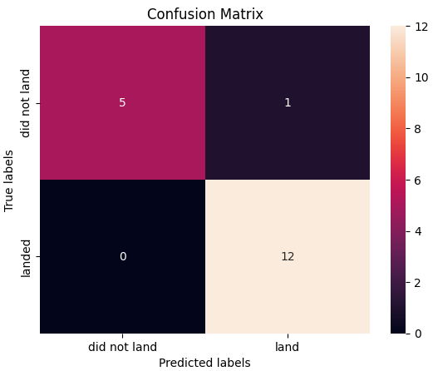
Confusion Matrix
The Decision Tree Classification performed best compared to other models tested
The confusion matrix showed that this model predicted
12 successful landings of actual successful landings, true positive
5 failed landings that were actual failures, true negative
1 successful landing that was actually a failed landing, false positive

Slide 45
Conclusions
Earlier flights were more likely to be unsuccessful relative to later flights
Flights from the launch sites KSC LC-39A and VAFB SLC 4E were more likely to be successful than those from CCAFS LC-40
Launches with heavier payloads were more likely to be successful relative to lighter payloads
ES-L1, GEO, HEO, SSO orbit types are the most successful
Success rate typically increase with additional launches at a site, GTO appears to be the exception
The launch site is located away from a population center and near the coast while maintaining adequate distance to highways and railroads
The Decision Tree Classification performed best compared to other when predicting a successful launch

Slide 46


